Slide 1


Slide 2

GitHub

Slide 3
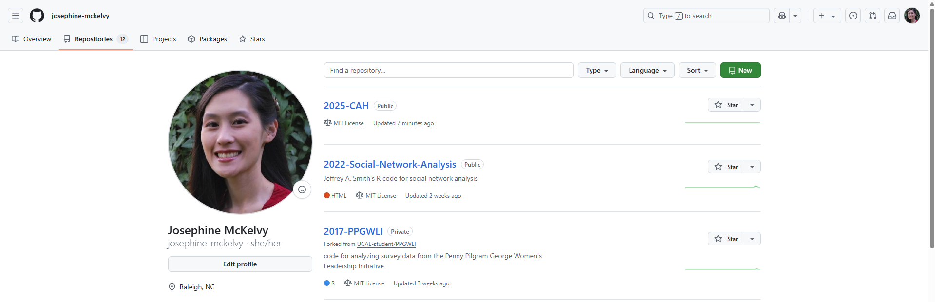
Notes:
Sign in to GitHub.
Create a new repository.

Slide 4
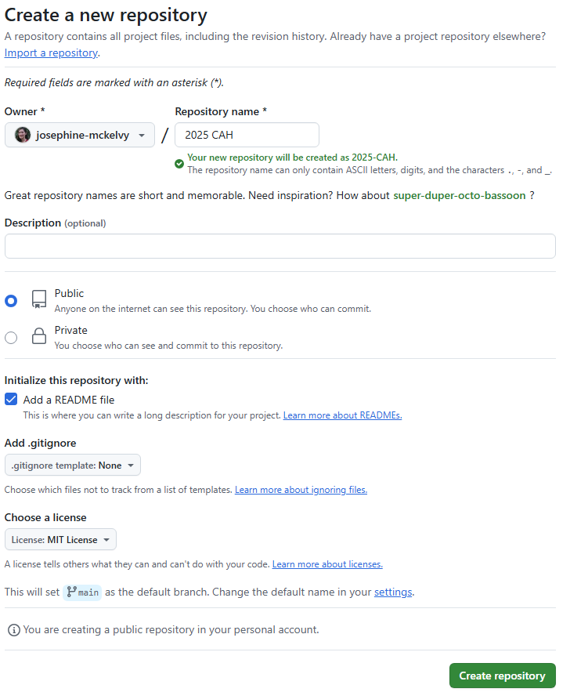
Notes:
Name the repository.
Add a README file.
Choose a license.

Slide 5


Slide 6
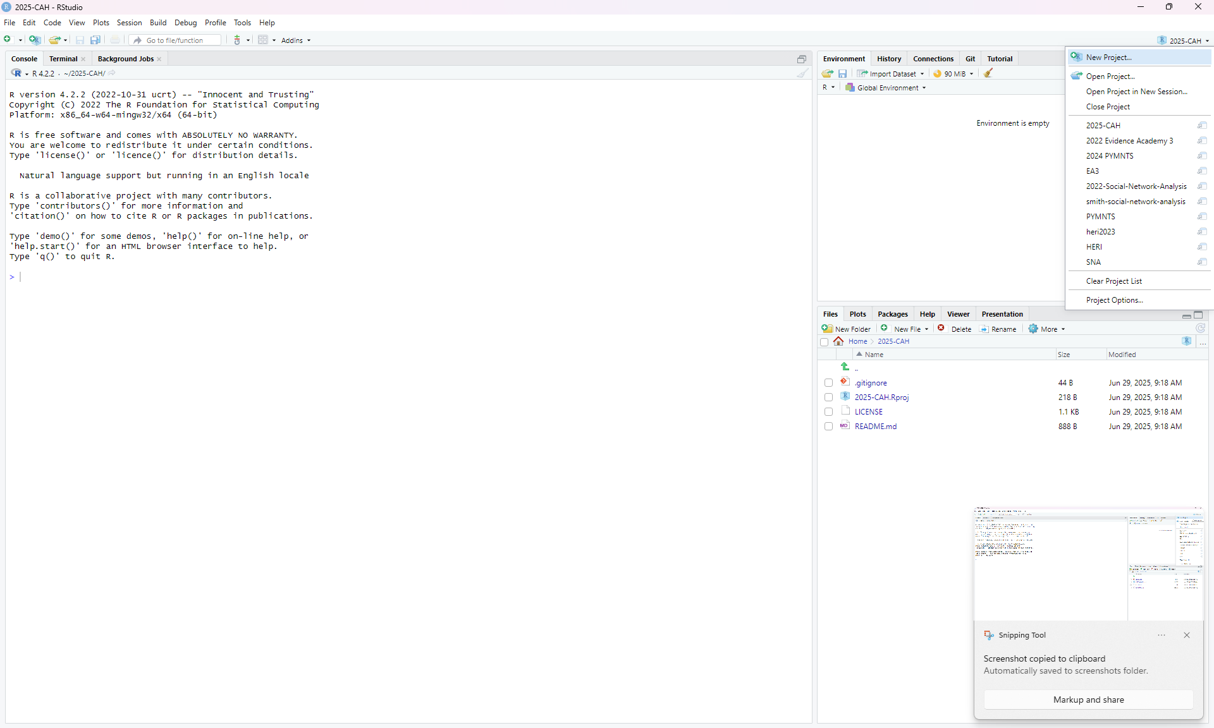
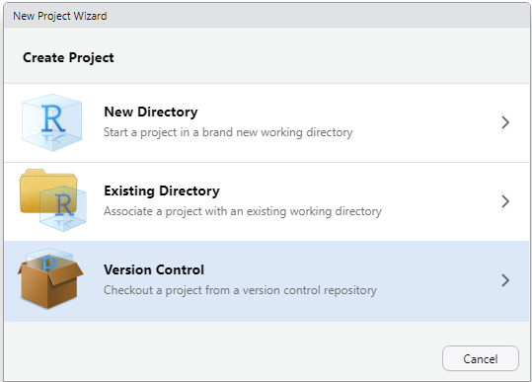
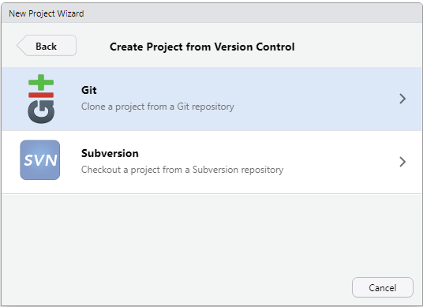
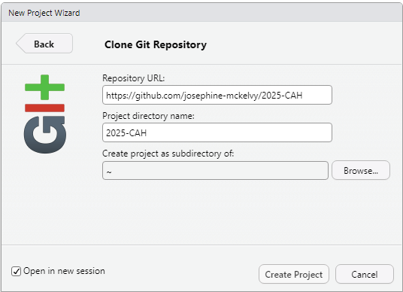
Notes:
Create a New Project.
Checkout a project from a Version Control repository.
Clone a project from a Git repository.
Use the URL for the repository you just created in GitHub.

Slide 7
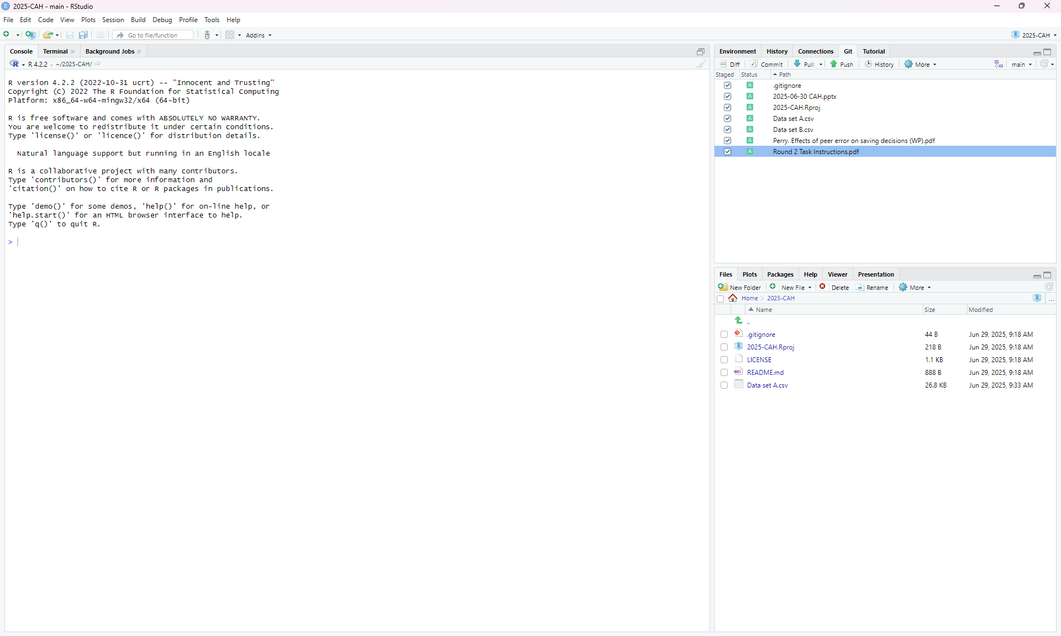
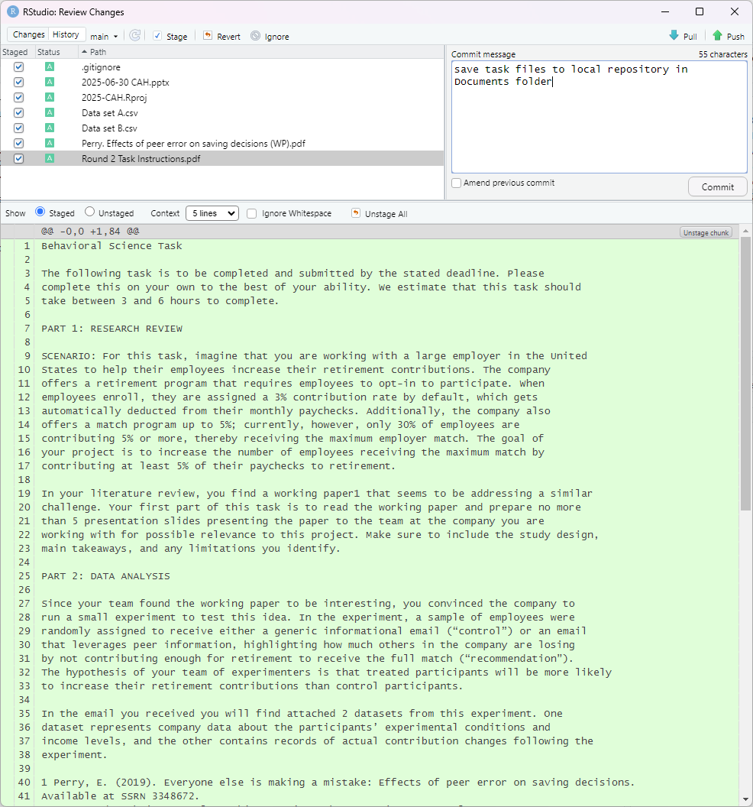
Notes:
Save task files to local repository (i.e., the relevant folder created in My Documents folder).
In the Git window, select changes to Commit (or save).
Describe changes, Commit changes, and Push changes to GitHub.

Slide 8
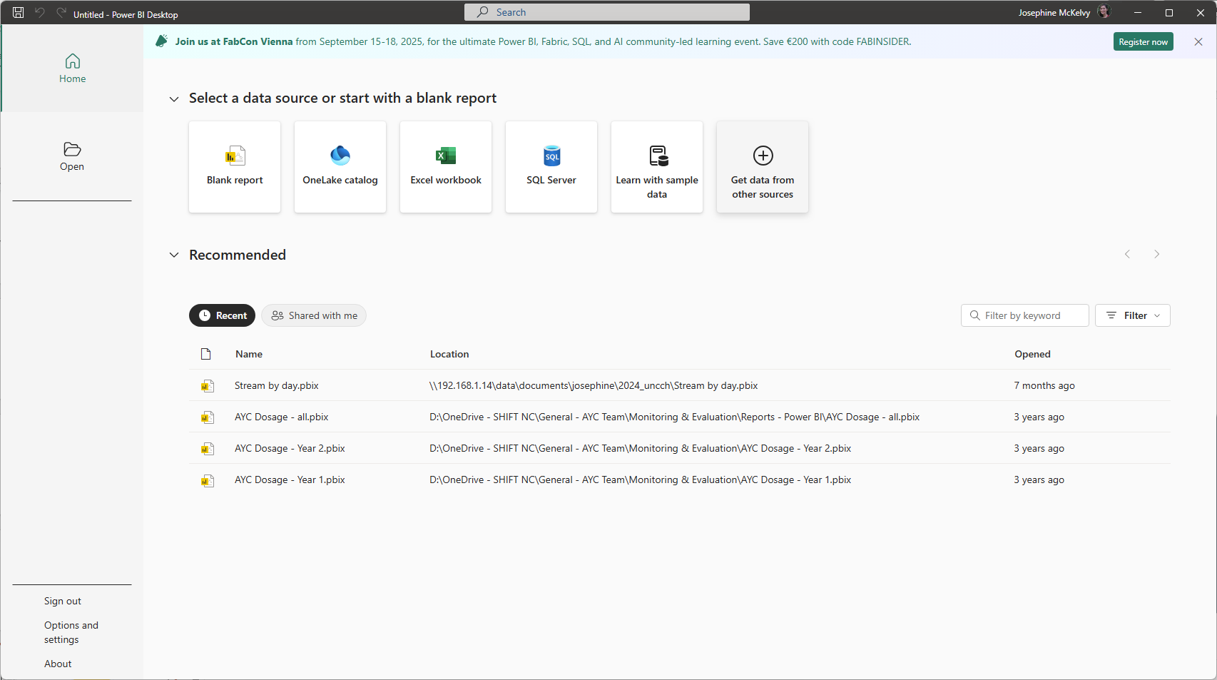
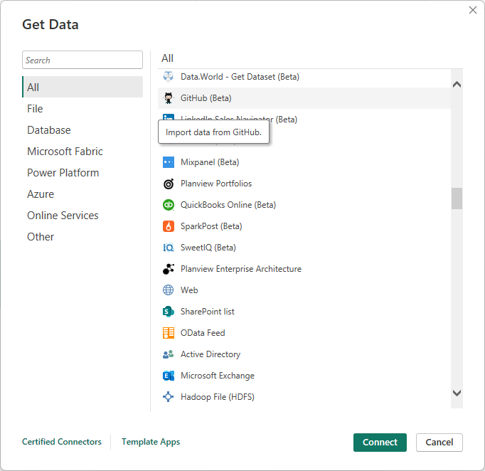
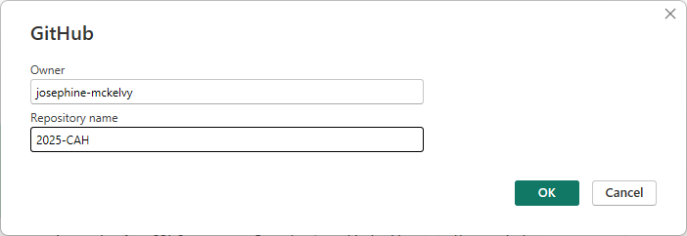
Notes:
PowerBI: Get data from other sources
GitHub:
Enter username for Owner and Repository Name.
Sign in.
Authorize.
Connect.

